Slide 1
CASE APPROVALS

Slide 2
Case approvals are decision points at which one or more users decide whether to approve or reject a case For an example , an employee submits a request for an equipment upgrade. Equipment upgrade request are sent to a manager, who either approve or rejects the request
Approvals can be added to a business process to seek consent from users with different roles or levels of expertise.

Slide 3
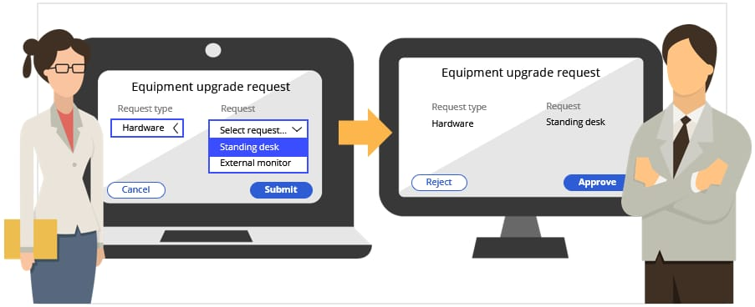

Slide 4
->There are two types of approval present here -> Single level Approval -> Cascading level Approval • Single level – Receive approval from a single user by indicating a specific user, work queue or business logic.

Slide 5
Casacading Approvals Receive approval from people on different levels of your organizational chart or in different parts or departments of your organization. A list of approvers is processed until the action is rejected or the last approver in the list approves the action.

Slide 6
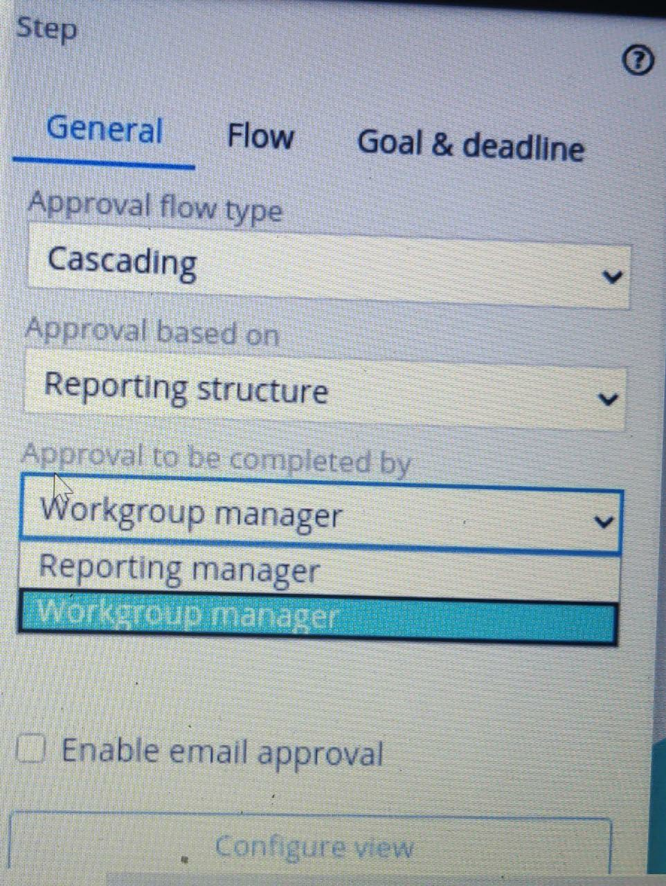
There are two types of casacading approvals : -> Reporting Structure -> Authority matrix Reporting Structure : Type of cascading approval that allows receiving approval from people on different levels of an organizational chart.

Slide 7
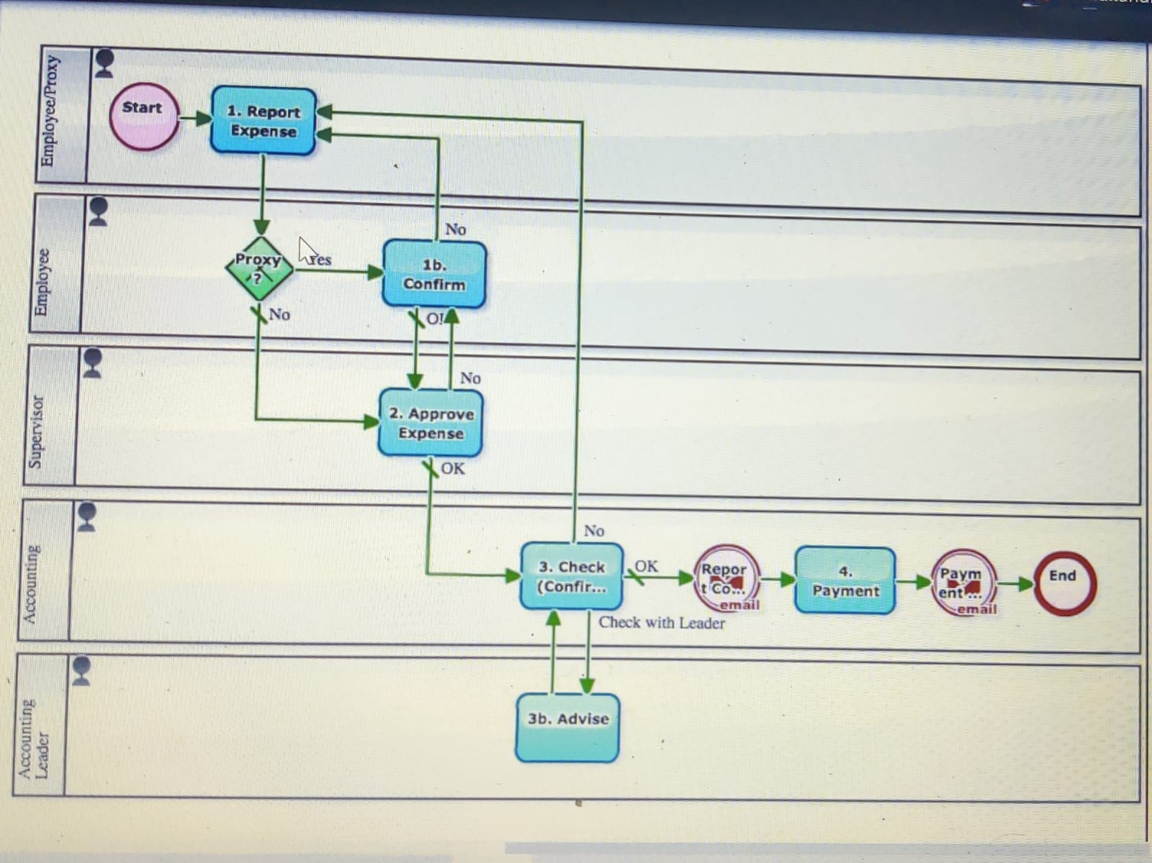

Slide 8
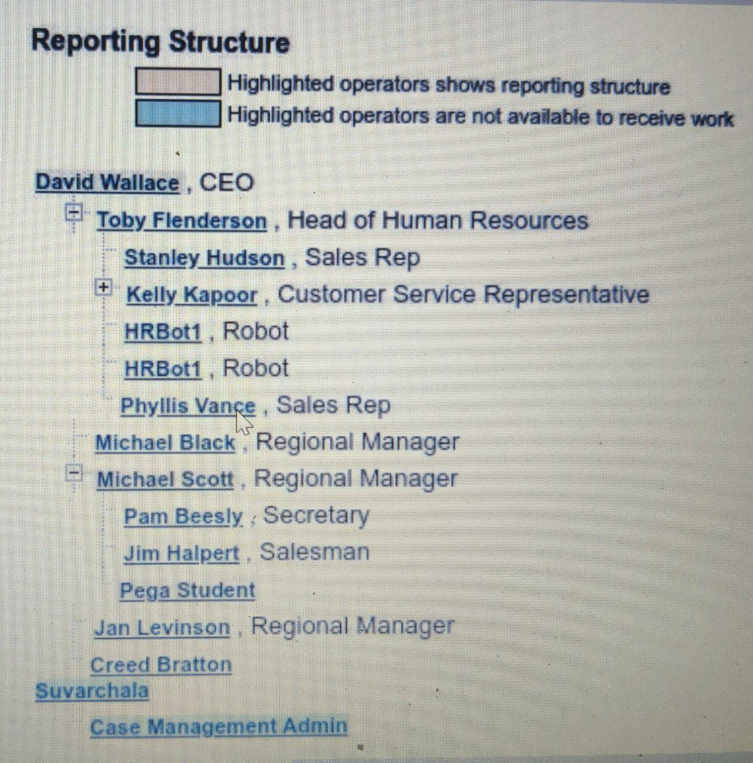
Determines which operator is the starting point in the reporting structure. – Reporting manager – Reporting manager of current user. – Workgroup manager – Manager of the current user’s default workgroup.

Slide 9
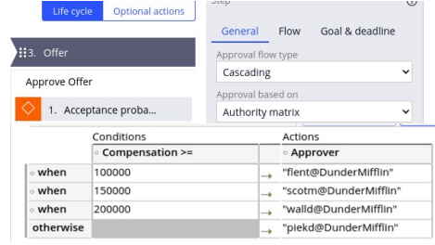
Authority Matrix : Used when a set of rules directs the approval chains to individuals both inside and outside the organization of the submitter • Implemented as a page list property of the case type

Slide 10
Populating the Authority Matrix • Pre-populate the list before the step Data Page Data Transform Decision Table • Use Decision Table to populate the list when the step is executed

Slide 11
Email Approval • Enable email approval to accept, reject, or take other actions on a case without login to the application. – The email includes an embedded prompt to accept or reject the case step. – The receiver clicks a button in the email message, which generates an email response that includes their decision and sends the email back to the application. • Configure at least one email account in the application that can send and receive emails.

Slide 12
THANK YOU

